Slide 1
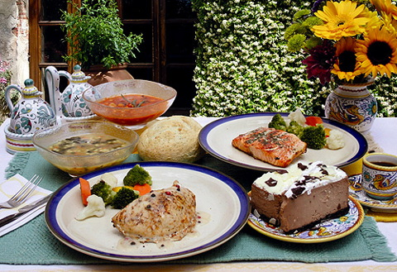
WEEKLY MEAL SELECTION GUIDELINES

Slide 2
WHEN PLANNING MEALS REMEMBER
This is a group assignment.
Each group will be responsible for all the decisions for one meal service.
You must consider your potential customers and avoid your personal preferences.
Remember that we are operating a business so special considerations should be taken when choosing recipes that require large quantities of specialty items.
Consider nutrition.
Limited class time will be allocated for working on this assignment.
Roles/responsibilities must be determined during planning.

Slide 3
OTHER CONSIDERATIONS
You should choose a theme for your meal
You will choose a main dish and a starch, dessert, a bread , possibly another side or drink.
Recipes for the original amount and the upsized 50 servings will be compiled and submitted for approval ONE WEEK prior to MEAL TRIAL.
Each group will present their meal to the class with a detailed two day time/work plan. The groups will be given feedback and allowed to make changes.
Your presentation should include a slide show depicting the theme, photos of the proposed dishes and how you expect them to look (plating), as well as a detailed menu description that would make a customers mouth water to read.
On the day of the meal, a customer evaluation must be administered to six customers.

Slide 4
AFTER MEAL SERVICE
A debriefing session will be held to discuss highlights and potential improvements.
The entire meal ( each recipe) should be costed to determine the profit/loss and handed into the teacher. (print the page from website)
A grocery list must be provided for 50 servings.
A resources list must be provided
All members of the groups must complete an e-portfolio entry including a self reflection and any other pertinent information. You can make this entry “what you want it to be”.

Slide 5
Checklist
Menu for a themed meal including bread, main, dessert.
Recipes for each product to serve original amount and upsized to 50 people
Cost per serving for each recipe must be determined and printed from the website
Groceries list must be created
Resources list must be generated
Prepare a schedule to create the meal, (prep day, meal day ) for all members of our class.
Customer evaluation cards made and collected
Evaluate yourself
Evaluate your partner

