Slide 1
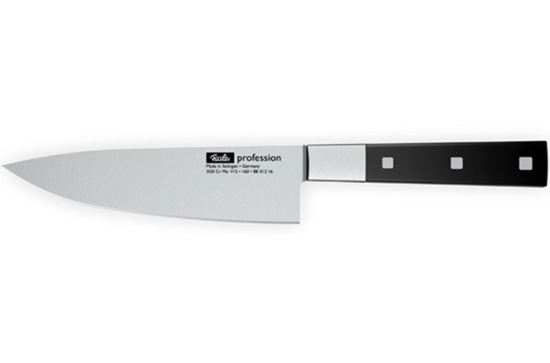
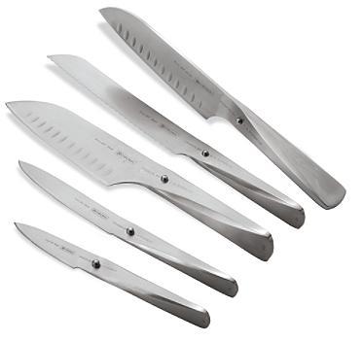
Knives and Knife Skills

Slide 2
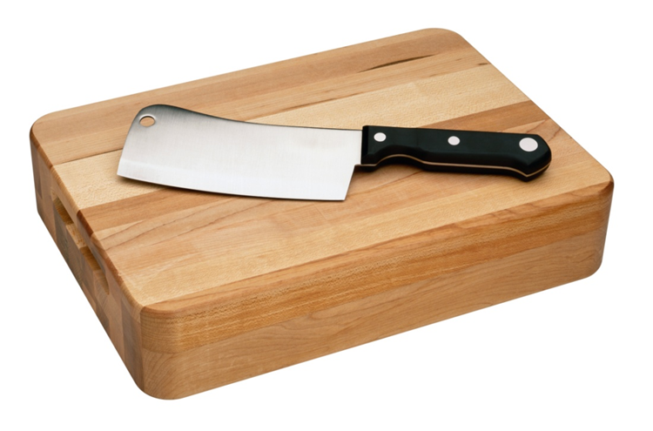
Knife Construction
Knives are the most commonly used kitchen tools
Chefs must be familiar with:
knife construction and type.
proper cutting techniques.
knife safety and care.

Slide 3
Knife Construction
Parts of a knife:

Slide 4
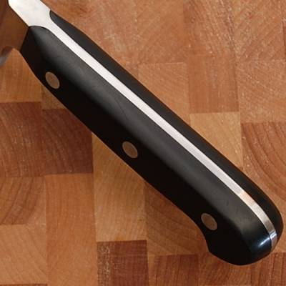
Tang

Slide 5
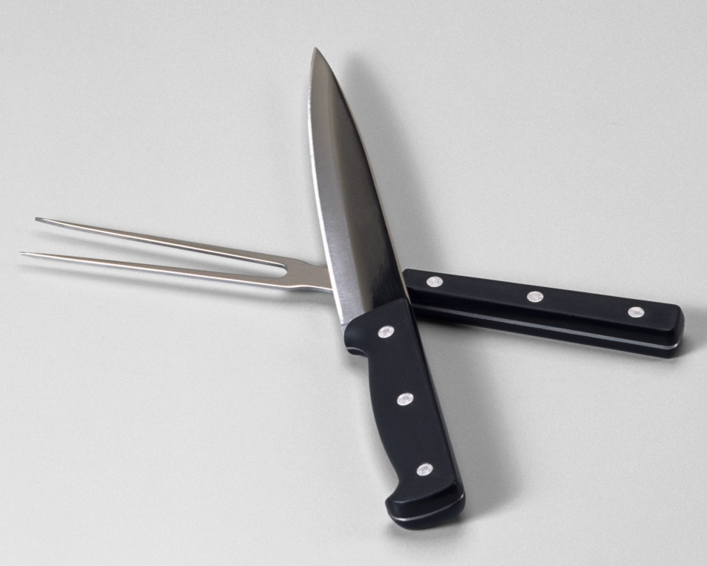
Knife Construction
Types of knives include:
chef’s knife
slicer
boning knife
paring knife
tournée knife
fillet knife
butcher knife

Slide 6
How to Hold a Knife
http://video.about.com/busycooks/How-to-Hold-a-Knife.htm

Slide 7
Why do we need Different Cuts?
1.Uniform cooking times.
2.Enhanced visual appeal.

Slide 8
Different Cuts
Knife cuts for slicing include:
Rondelle – disk shaped slice

Slide 9
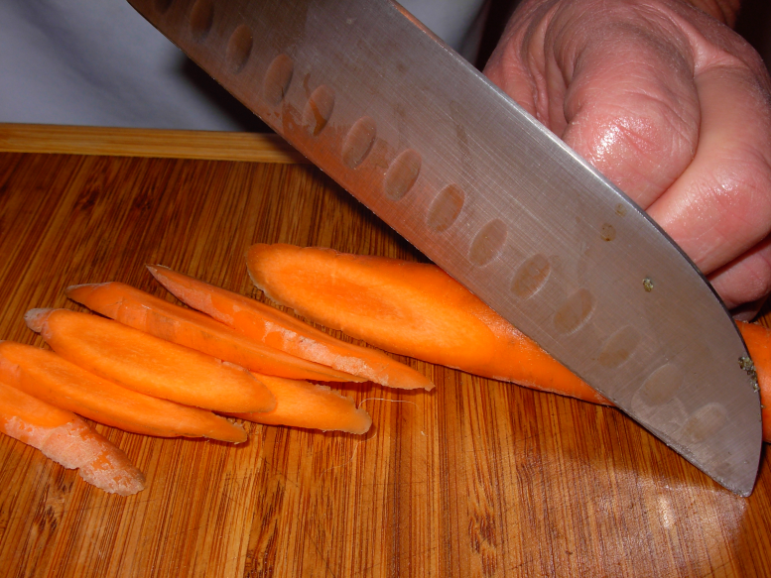
Knife Skills
Knife cuts for slicing include:
Diagonal – a cut
the results In an oval or
elongated slice of a round
fruit or vegetable

Slide 10
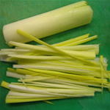
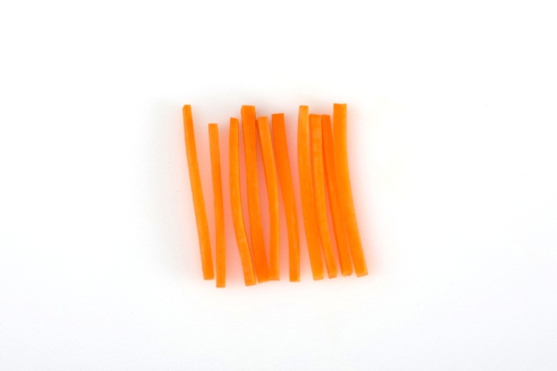
Knife Skills
Mincing cuts include:
Julienne - 1⁄8-inch thick matchstick-shaped cuts. Can very in size.

Slide 11
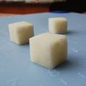
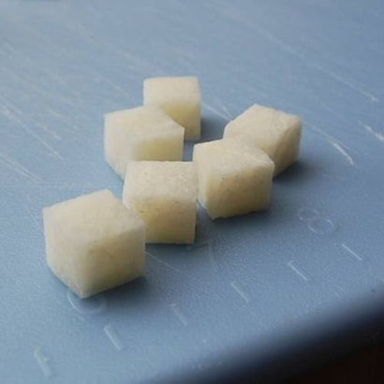
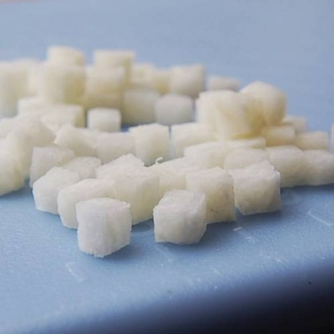
Knife Skills
Dicing cuts include:
Diced - cut into small blocks
Large- cubed Small - minced
Large
Medium
Small

Slide 12
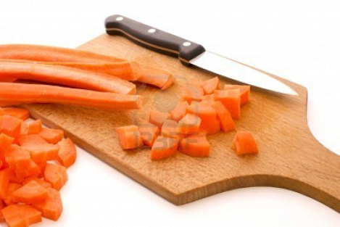
Today’s Lab
Practice your knife skills.
Cut an example of the 4 knife cuts given to you in class. When complete:
Place on a paper plate with your name on it.
Labeling each of the knife cuts.
Clean and check out of your kitchen.

Slide 13
Review
Knife safety and skills
http://www.foodnetwork.com/videos/knife-basics/65741.html?vpid=tbla|singlevideolp
JJC clips on how to dice an onion and an avocado
How to seed a tomato
http://www.bing.com/videos/search?q=seeding+a+tomato&view=detail&mid=E8845898793360465404E8845898793360465404&first=0&FORM=LKVR5

Slide 14
One more video………
http://www.foodnetwork.com/videos/basic-knife-skills/3650.html

